Slide 1
SSD: A UNIFIED FRAMEWORK FOR SELFSUPERVISED OUTLIER DETECTION (ICLR 2021)
이미지처리팀
고형권, 김준철, 김병현(발표자), 이예은, 이희재, 조경진

Slide 2
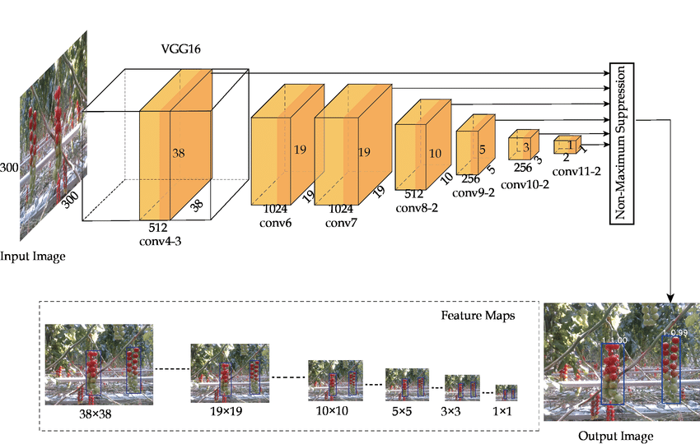
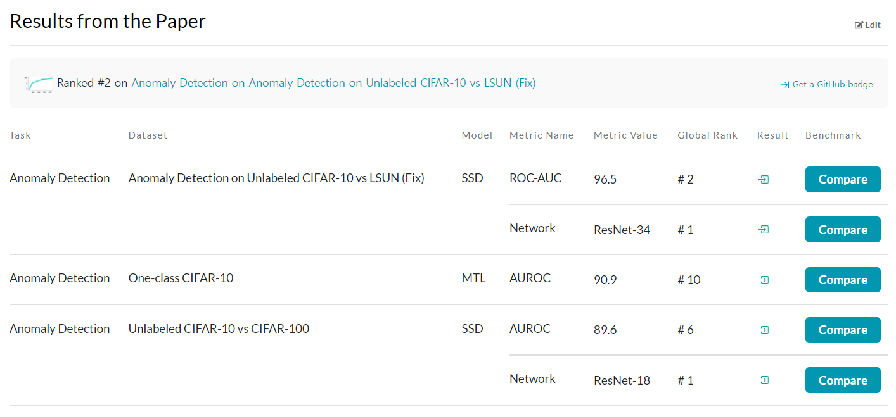
What is SSD??
SSD
Not the well-known light weight object detection model
Outlier Detector published in ICLR 2021, top-ranked on some of the anomaly detection tasks in Papers-with-Code.
SSD: Object Detector
SSD : Outlier Detector

Slide 3
What is SSD??
SSD
Not the well-known light weight object detection model
Outlier Detector published in ICLR 2021, top-ranked on some of the anomaly detection tasks in Papers-with-Code.
SSD: Object Detector
SSD : Outlier Detector

Slide 4
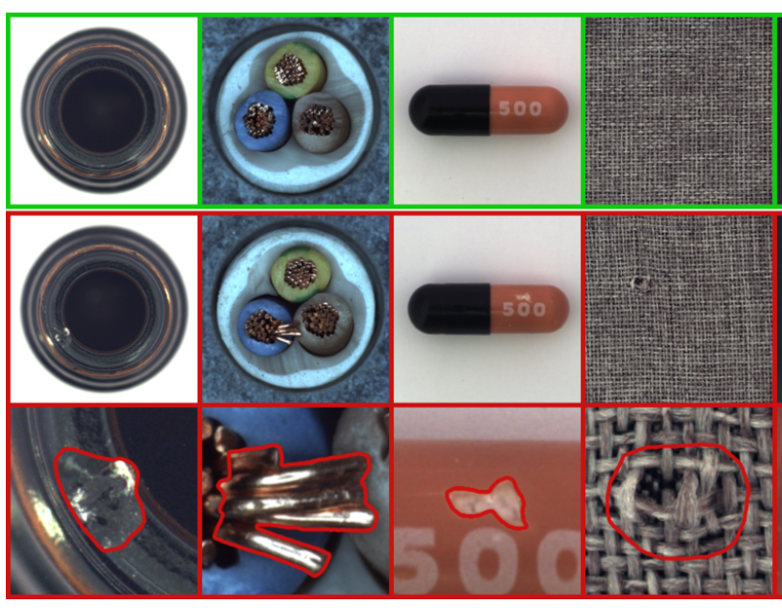
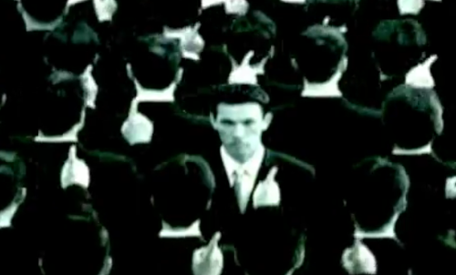
What is Outlier Detection??
Outlier Detection (Anomaly Detection)
Machine learning task to determine whether a given data is inside or outside of normal data distribution
Many field applications, including cyber security, medicine, machine vision, statistics, neuroscience, law enforcement, and financial fraud
Normal Class
Anomaly Class
Outlier….
Anomaly Segmentation
모두가 ‘아니오’ 할 때, ‘예’라 할 수 있는 용기 (?)
Industrial Application (MV-Tec Dataset)
https://www.mvtec.com/company/research/datasets/mvtec-ad

Slide 5





Difficulties in Outlier Detection
Dilemma between supervised and unsupervised learning
Supervised
learning
Requires expensive labeling cost
Find a method to reduce labeling cost
Poor Performance
Unsupervised Learning

Slide 6
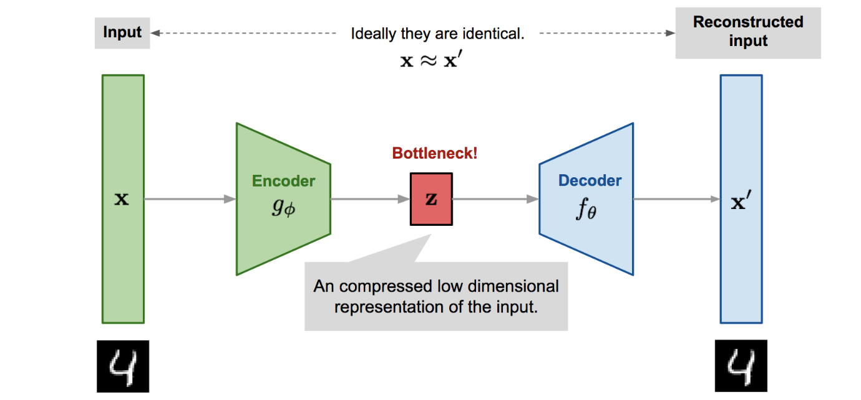
Difficulties in Outlier Detection
How to effectively train a model to extract meaningful features for outlier detection
Autoencoder is not good enough for outlier detection
Though useful for tasks such as dimensionality reduction, we find that these representations are not good enough to sufficiently distinguish in-distribution data and outliers.
Illustration of autoencoder model architecture.
https://lilianweng.github.io/posts/2018-08-12-vae/

Slide 7
How to Train a Robust Outlier Detectors?
Key Tasks for successful outlier detector training
Modeling features of in-distribution data without requiring class labels
Outlier Detection with Unsupervised Learning
Learning a good feature representation with unsupervised training methods
Contrastive Learning
Contributions of SSD
SSD for unlabeled data
Application of contrastive learning to in-distribution feature learning
Choice of distance metric: Mahalanobis distance
Cluster-conditioned detection
Extensions of SSD
Few shot outlier detection
State-of-the-art performance

Slide 8
Q & A
Q & A

Slide 9







SSD: Self-Supervised Outlier Detection
Overall Framework of SSD
Training Set
…..
Dog Images (Normal Class)
$$x_{n+1}$$
$$x_{n+1}$$
1. Contrastive Loss
(Only with positive labels)
CNN
$$x_{n}$$
$$x_{n}$$
Simplified normal class distribution before training
Simplified normal class distribution after training

Slide 10
SSD: Self-Supervised Outlier Detection
Overall Framework of SSD
Training Set
…..
Dog Images (Normal Class)
2. (Optional) after-training data distribution clustering (K-means clustering)
$$x_{n+1}$$
$$x_{n+1}$$
1. Contrastive Loss
(Only with positive labels)
CNN
$$x_{n}$$
$$x_{n}$$
Simplified normal class distribution before training
Simplified normal class distribution after training

Slide 11


SSD: Self-Supervised Outlier Detection
Overall Framework of SSD
Training Set
Test Set
…..
Dog Images (Normal Class)
Dog Image (Normal Class)
Cat Image (Outlier Class)
$$x_{n+1}$$
3. Anomaly Detection
(Mahalanobis Distance)
$$x_{n+1}$$
CNN
$$x_{n}$$
$$x_{n}$$
Simplified normal class distribution before training
Simplified normal class distribution after training

Slide 12
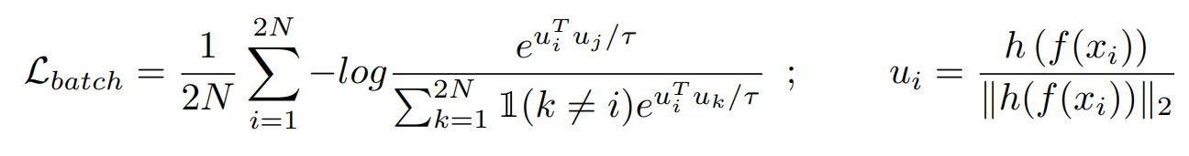


Unsupervised Outlier Detection with SSD
Leveraging contrastive self-supervised training
Contrastive Loss
Using image transformations, it first creates two views of each image commonly referred to as positives.
Next, it optimizes to pull each instance close to its positive instances while pushing away from other images, commonly referred to as negatives.
: projection header
(A function maps the input space to the feature space)

Slide 13
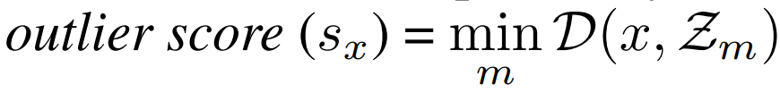
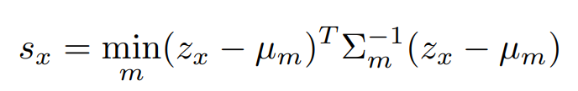


Unsupervised Outlier Detection with SSD
Cluster-conditioned detection
K-means clustering
Partition the features for in-distribution training data in m clusters
Calculate the outlier score for each test input x, where D(., .) is a distance metric in the feature space
Input 1
$$x_{n+1}$$
Input 2
$$x_{n}$$
Simplified normal class distribution after training

Slide 14
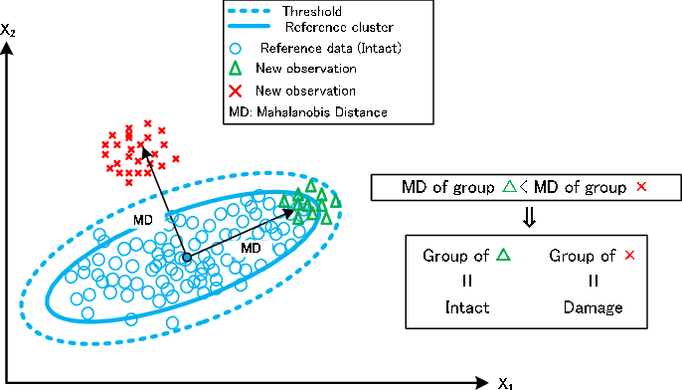
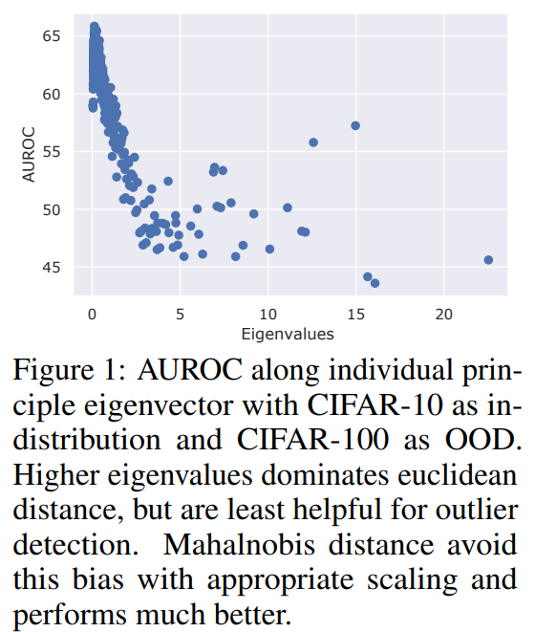
Unsupervised Outlier Detection with SSD
Choice of distance metric
Mahalanobis distance
With euclidean distance, i.e., in absence of scaling, components with higher eigenvalues have more weight but provide least discrimination. Scaling with eigenvalues removes the bias, making Mahalnobis distance effective for outlier detection in the feature space.
Concept of Mahalanobis Distance
https://www.researchgate.net/figure/Concept-of-Mahalanobis-distance-MD_fig7_277670816

Slide 15
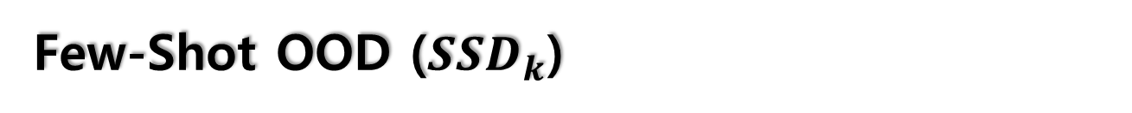
Few-Shot OOD (${SSD}_{k}$)
One-Shot or Five-Show OOD
Refers to access to only one and fives samples, from each class of the targeted OOD dataset, respectively
Outlier Score
Shrunk covariance estimators and data augmentation

Slide 16
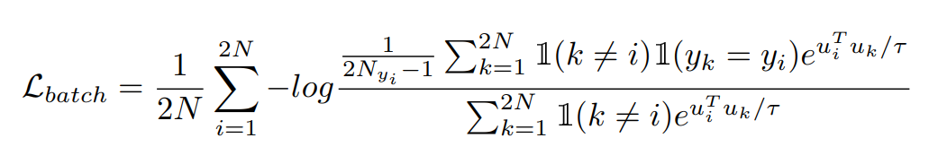
How to Best Use Data Labels (SSD+)
Incorporating labels in contrastive self-supervised training
Supervised contrastive training loss
Use images with identical labels in each batch as positives

Slide 17
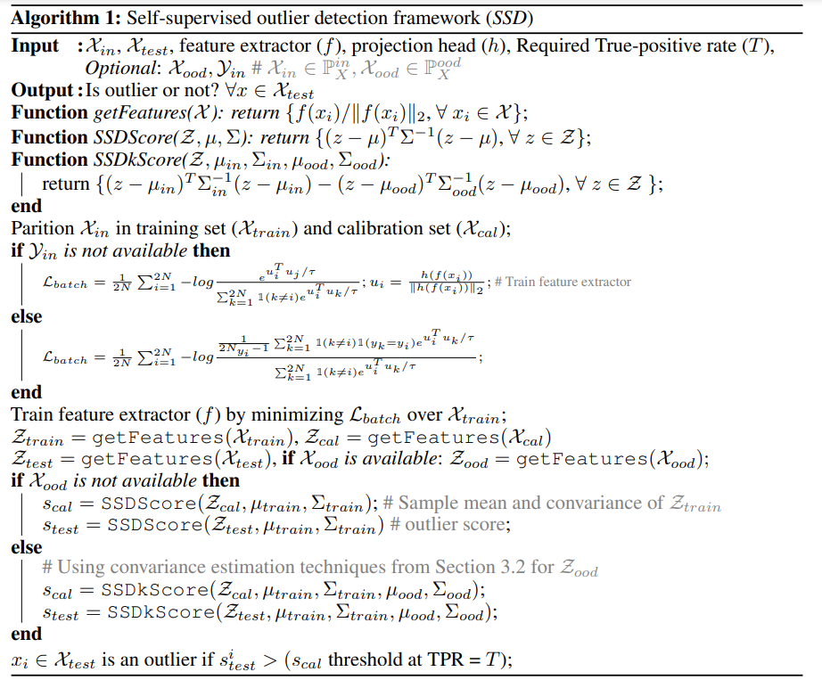
SSD Algorithm

Slide 18
Q & A
Q & A

Slide 19
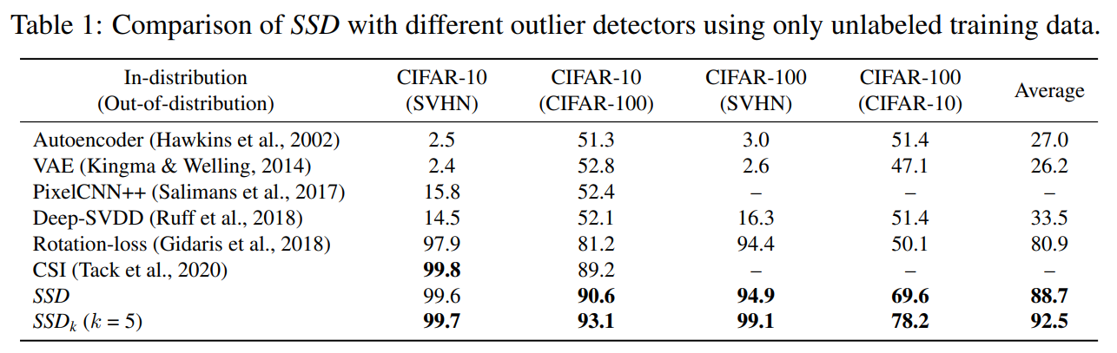
Experiments
Comparison with unsupervised learning-based detectors

Slide 20
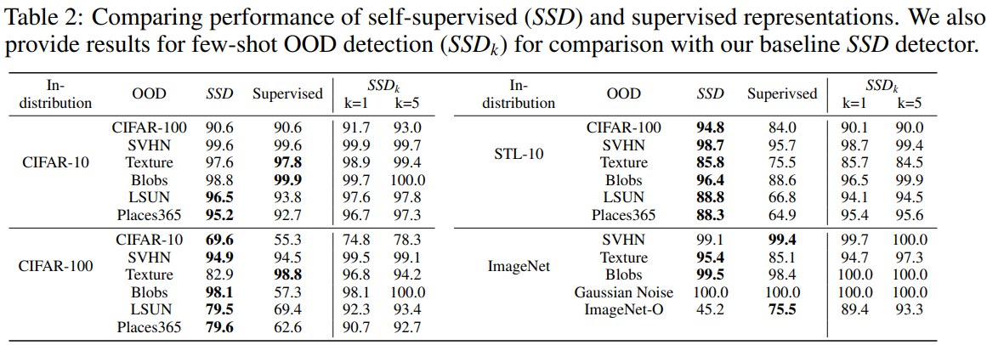

Experiments
Few-Shot OOD (${SSD}_{k}$)

Slide 21
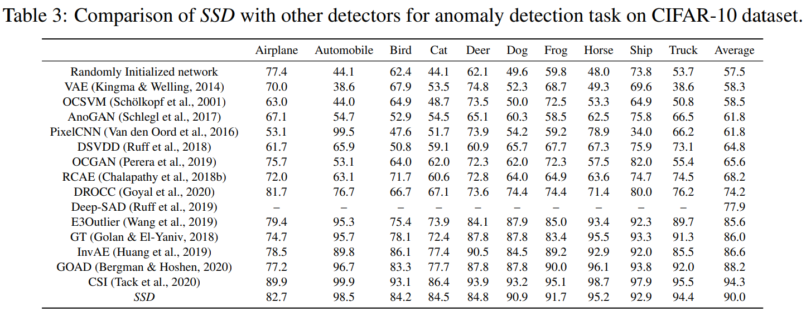
Experiments
Comparison with Other Networks

Slide 22
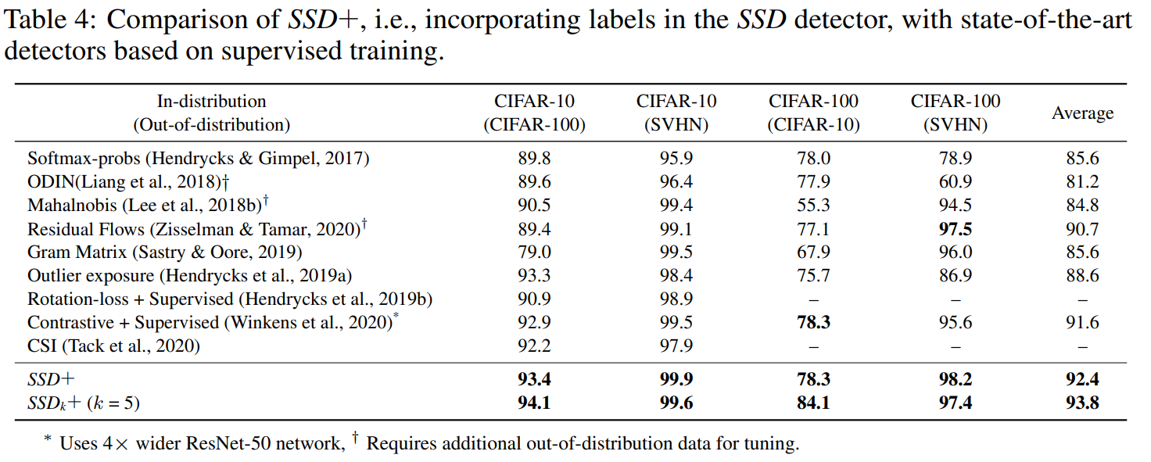

Experiments
Few-Shot OOD ($SSD+$)

Slide 23
Discussion and Conclusion
On tuning hyperparameters in SSD
Additional parameter tuning is avoided
For example, we use a standard set of parameters for self-supervised training and model the learned features with a single cluster.
Why contrastive self-supervised learning is effective in the SSD framework?
Contrastive learning
Earlier works have shown that such contrastive training forces the network to learn a good set of feature representations.
However, a smaller value of temperature quickly saturates the loss, discouraging it from further improving the feature representations.
We find that the performance of SSD also degrades with lower temperature, suggesting the necessity of learning a good set of feature representation for effective outlier detection.

Slide 24
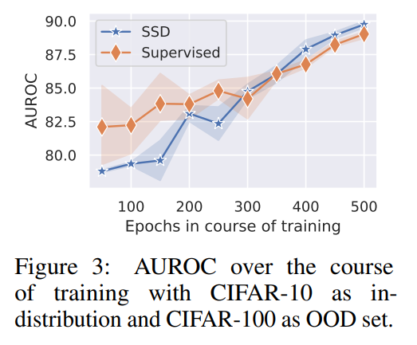
Discussion and Conclusion
How discriminative ability of feature representations evolves over the course of training
While discriminative ability of self-supervised training in SSD is lower at the start, it quickly catches up with supervised representations after half of the training epochs.
Why contrastive self-supervised learning is effective in the SSD framework?
Performance of SSD improves with the amount of available unlabeled data
A compelling advantage of unsupervised learning is to learn from unlabeled data, which can be easily collected.

Slide 25
Q & A
Q & A

